Slide 1
Animal Detection for
generative AI
NAME : K.NANTHINI
REG NO : 712221104010
DEPT : B.E (CSE) & 3rd year
COLLEGE : PARK COLLEGE OF ENGINEERING AND TECHNOLOGY

Slide 2
Agenda
Problem Statement
Project Overview
End Users
Our Solution and Proposition
Key Features
Modelling Approach
Results and Evaluation
Conclusion

Slide 3
PROBLEM STATEMENT
The advent of generative artificial intelligence (AI) has unlocked various possibilities in creative content generation, including images, music, and text. However, one area that remains challenging is the accurate detection and understanding of animals within generated content. Current AI models often struggle with recognizing and representing animals faithfully, leading to inaccuracies, distortions, or even absence of animals in generated outputs

Slide 4
Project overview
The project aims to develop an efficient and accurate animal detection system tailored for generative artificial intelligence (AI) applications. Recognizing the importance of animals in creative content generation, this project focuses on enhancing the capabilities of AI models to detect, classify, and incorporate animals seamlessly into generated outputs, such as images, videos, and other multimedia content.

Slide 5
End users
Content Creators
Entertainment industry professionals
Educators and Researchers
Al Developers and Enigineers
General users
Conservationists and Wildlife Biologists

Slide 6
Our solution and Proposition
Data Collection: Gather a diverse dataset of animal images covering various species, poses, and backgrounds.
Preprocessing: Clean and preprocess the data to remove noise, standardize sizes, and possibly augment the dataset to increase variability.
Detection Module: Integrate a detection module into the generative model to enable it to identify animals within generated images. This module could utilize techniques such as object detection or image segmentation. Evaluation: Evaluate the performance of the model using metrics like accuracy, precision, recall, and F1 score on a separate validation dataset.

Slide 7
Key features
Robustness to Variability
Ethical considerations
Compatibility
Adaptability
Accuracy
Anomaly detection

Slide 8
Modeling and approach
Model Selection: Choose a suitable deep learning architecture for object detection, such as YOLO (You Only Look Once), Faster R-CNN (Region-based Convolutional Neural Networks), or SSD (Single Shot MultiBox Detector). These models are known for their accuracy and efficiency in detecting objects in images.
Transfer Learning: Utilize pre-trained models on large datasets like COCO or ImageNet to leverage learned features and accelerate training. Fine-tune the model on your animal detection dataset to adapt it to your specific task. Training: Train the model using annotated images of animals. Use techniques like batch normalization, dropout, and learning rate scheduling to improve convergence and prevent overfitting.

Slide 9
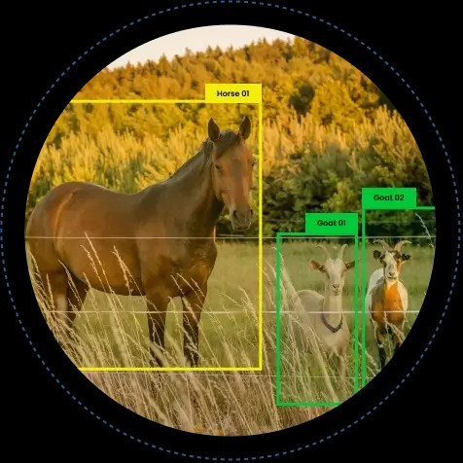
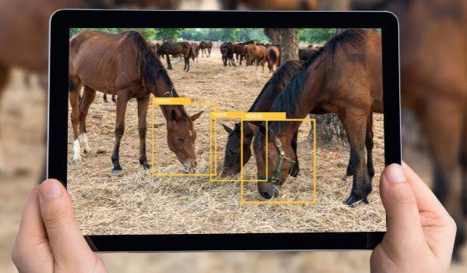
Result

Slide 10
Conclusion
In conclusion, animal detection for generative AI presents significant opportunities for various applications, including wildlife conservation, veterinary medicine, and entertainment. By leveraging advanced machine learning algorithms and training models on extensive datasets, we can enhance the accuracy and efficiency of animal detection systems. However, challenges such as data scarcity, diverse environmental conditions, and ethical considerations must be addressed to ensure the responsible development and deployment of such technology. With further research and collaboration between experts in AI and ecology, we can unlock the full potential of animal detection for the benefit of both animals and humans.

